Slide 2
IMPACT OF THE NatRisk PROJECT AT UNIVERSITY OF BANJA LUKA

Slide 3
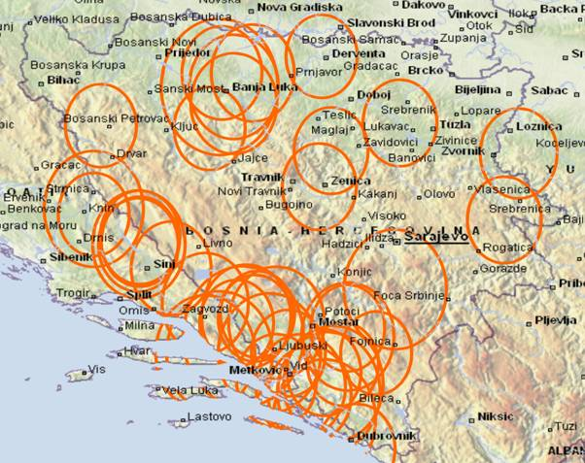
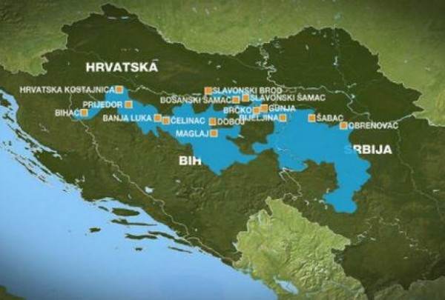
EDUCATIONAL AND SCIENTIFIC INFLUENCE
BANJA LUKA UNIVERSITY – OVER 70 MASTER STUDY PR. – 20 000 STUDENTS (over 100 tempus project since 1995-2015, 10 Erasmus project at the moment)
FIRST STUDY PR. ON NATURAL DISASTER RISK ISSUES (over 1000 km of river flows, drought issues in area of Semberija, Posavina, Lijevce polje, fires in Herzegovina, landslides in Krajina Birac area)

Slide 4
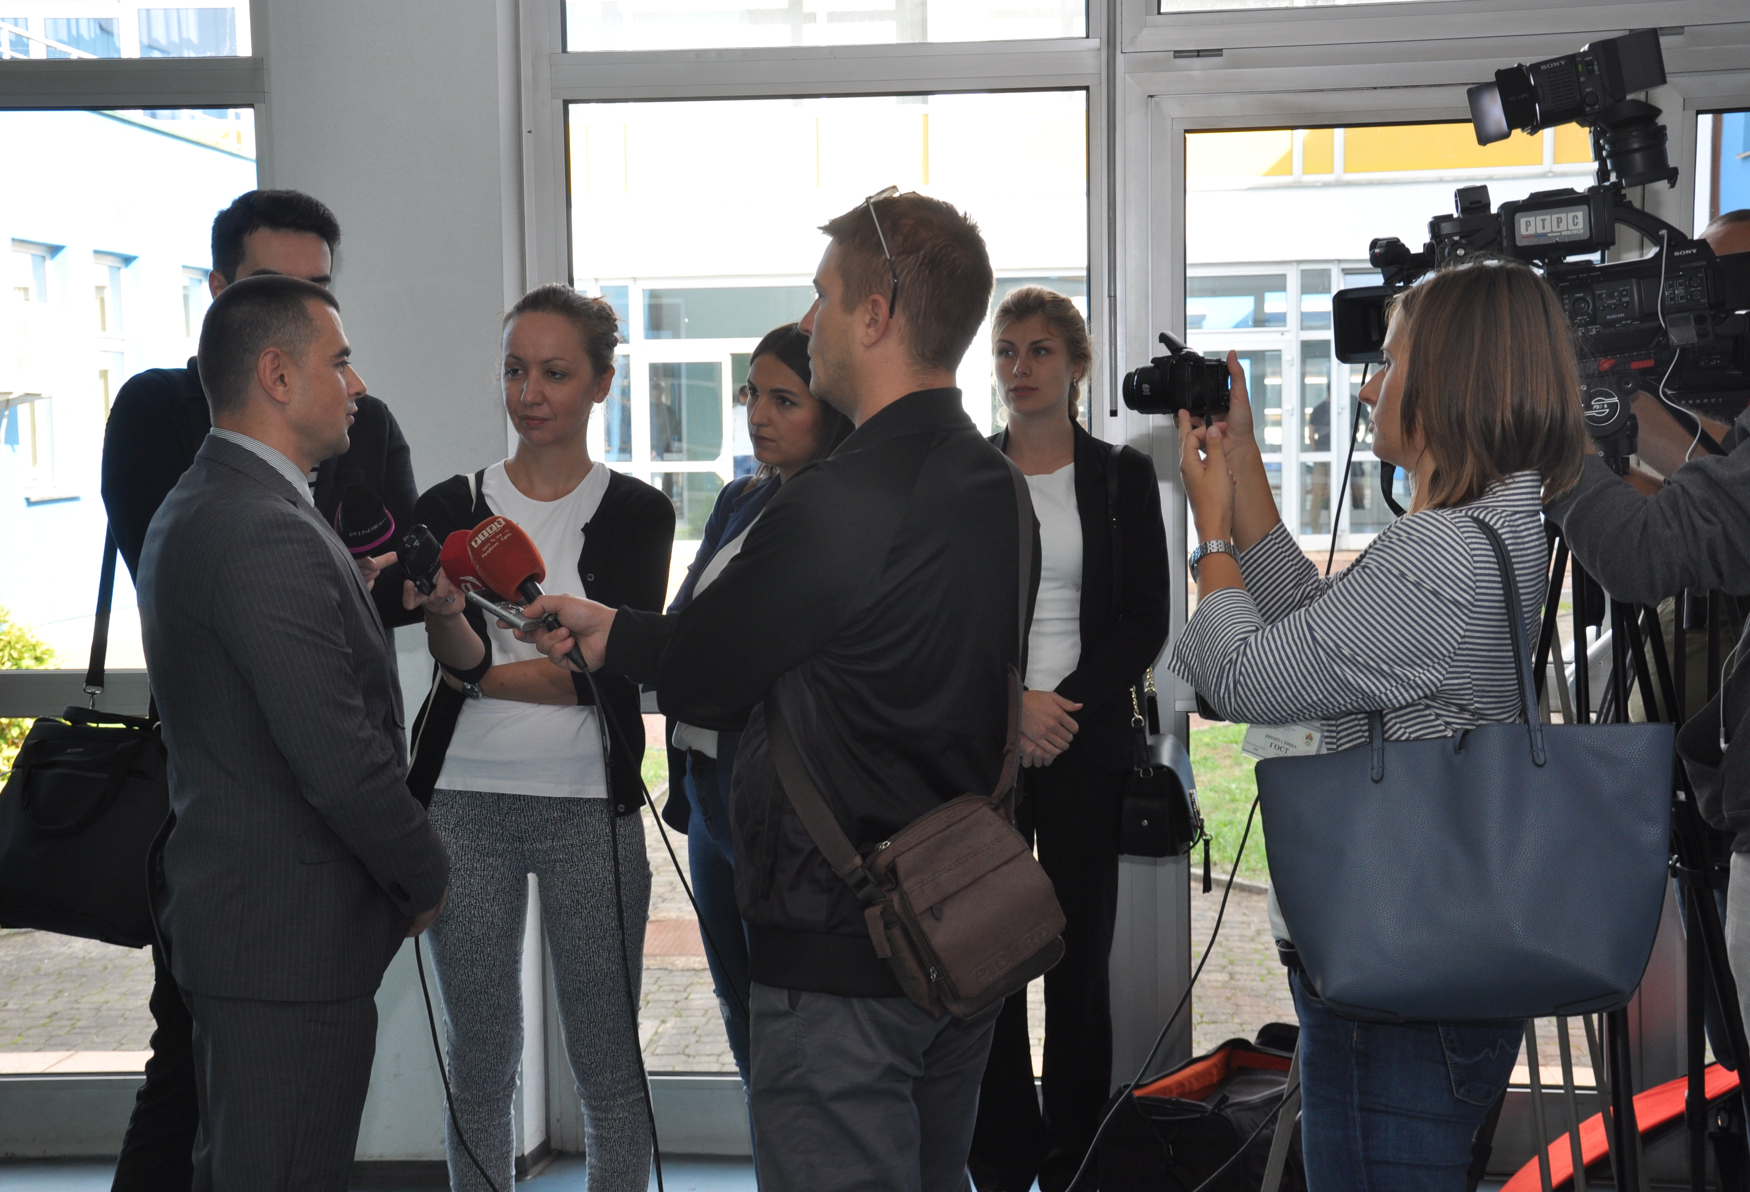
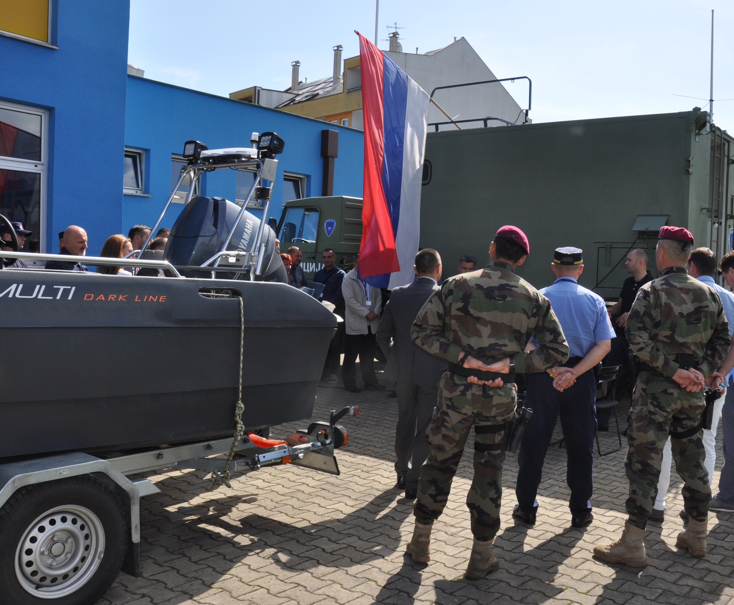
VISIBILITY IN MEDIA
2 REPORTAGE BY NATIONAL TV ON NATRISK ACTIV. ON BANJA LUKA UNIVERSITY
TWO EVENTS CONSIDERING STUDENTS AN PUBLIC SECTOR (grade 4.8).
BIG INTEREST OF STUDENTS (we raised quote from 15 to 30 students)

Slide 5
DIVERGENCE OF FACULTIES AND INSTITUTIONS
COOPERATION WITH FACULTY OF NATURAL SCIENCE ANG FACULTY OF CIVIL ENGINEERING.
CIVIL PROTECTION SERVICE (contract)
MOUNTAIN RESQUE SERVICE
METEREOLOGICAL INSTITUTE OF R. SRPSKA (contract).
MINISTRY OF INTERIOR (majority number of our students are employed in Ministry)

Slide 6
FINANCIAL AND MATERIAL INFLUENCE
88 000 euros is amount of grant of NatRis project.
We received 12 000 (2 instalment) + 28 000 euros for public procurement of equipment, software and books.
45 % OF TOTAL AMOUNT IS SPENT (DUE TO LEGAL TRANSOFRMATION SCHOOL OF MINISTRY OF INTERIOR INTO FACULTY OF SECURITY SCIENCE AND ELECTION OF RECTOR - unexpected).
35 piecesof PCs and laptops, printers, smart board, software.
50 books etc.

Slide 7
EXPERIENCE
15 PEOPLE ARE INVOLVED
PROCEDURE OF WRITING ELABORATE, DISSEMINATION, ACCREDITATION OF ST.PR….
WE WERE AT 6 PROJECT MEETING

Slide 8
SMS
RULEBOOK FOR MOBILITY OF STUDENTS AND STAFF WAS ADOPTED IN DECEMBER OF 2017.
ACT ON INTERNALISATION WAS ADOPTED ON DECEMBER 2017.
Salje | Prima | Broj | Trajanje, dana
UNIBL | KPA | 3 | 7
UPKM | UNIBL | 3 | 7
UNIBL | OE | 3 | 7
TCASU | UNIBL | 3 | 7
Salje | Prima | Broj | Trajanje, mjeseci
KPA | UNIBL | 2 | 5
UNIBL | KPA | 2 | 5
UNIBL | OE | 1 | 2

